Slide 1
Expression, Type conversion, Precedence and Associativity

Slide 2
Evaluation an expression
int a, b, c, x, y, z;
a=9;
b=12;
c=3;
x=a - b / 3 + c * 2 - 1;
y = a - b / (3 + c) * (2 - 1);
z = a - ( b / (3 + c) * 2) - 1;
x =
y =
z =
10
7
4

Slide 3
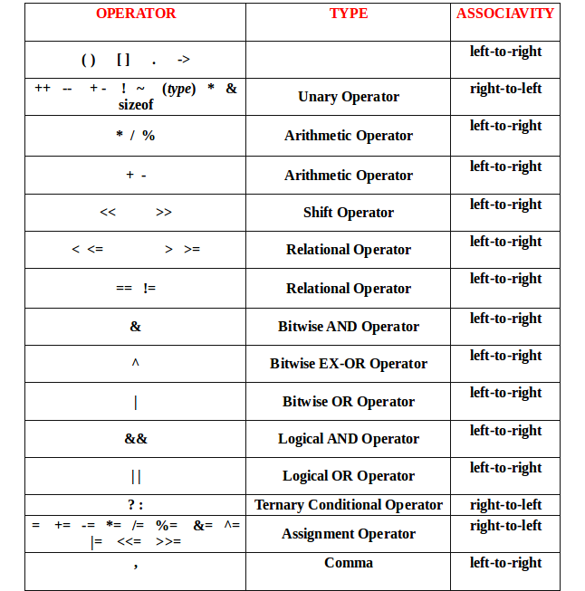

Slide 4
Rules for evaluation of expression
The expressions within parentheses assume highest priority
If parentheses are nested, the evaluation begins with the innermost sub expression
The precedence rule is applied in determining the order of application of operators.
The associatively rule is applied when 2 or more operators of the same precedence level appear in a sub expression.

Slide 5
Evaluation an expression
int sum;
int count;
sum = 17;
count = 5;
int mean;
mean = sum / count;
mean = 3

Slide 6
Evaluation an expression
int sum;
int count;
sum = 17;
count = 5;
float mean;
mean = sum / count;
mean = 3.000000

Slide 7
Implicit Type Conversion
float sum;
int count;
sum = 17;
count = 5;
float mean;
mean = sum / count;
mean = 3.400000
Implicit Type Conversion

Slide 8
Explicit Type Conversion
int sum;
int count;
sum = 17;
count = 5;
float mean;
mean = sum / count;

Slide 9
Explicit Type Conversion
int sum;
int count;
sum = 17;
count = 5;
float mean;
mean = (float) sum / count;
mean = 3.400000
Explicit Type Conversion

Slide 10
Conversion Order
long double
double
Conversion
Hierarchy
float
unsigned long
long
unsigned int
int
short
char

Slide 11
I/O Function
Standard input functions:
scanf()
getch()
getche()
getchar()
gets()
Standard output functions:
printf()
putchar()
puts()

Slide 12
That’s all

